Slide 1
Ascension SUPPLIER Webinar
Ascension Release 11 August, 2019
Please Note:
Ensure your phone is on mute.
Hold your questions until the end of the webinar.
Be sure to connect to the audio portion of today’s webinar.

Slide 2
Agenda
Background on Ascension Release 11
Overview of Changes
Changes to Purchase Orders, Invoices & Payments
PeopleSoft Supplier Portal Functionality
Amount Only Purchase Orders
Invoice Submissions
Reference Information / Questions

Slide 3
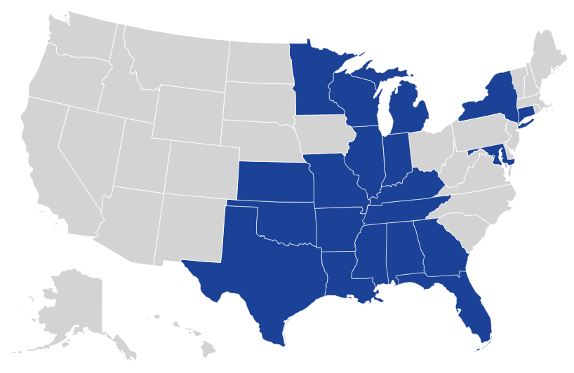
About Ascension
Ascension, which provided nearly $2 billion in care to persons living in poverty and community benefit programs last year, is the nation’s largest Catholic and non-profit health system. Our Mission-focused health ministries employ more than 156,000 associates serving in more than 2,600 sites of care in 20 states.
Over the past several years, Ascension has embarked on a significant initiative and change management strategy. The changes facilitate efficiency, focus our resources, and provide analytics capabilities that inform our operational and clinical decisions.
20 states

Slide 4
About THE INITIATIVE
The initiative was launched in October, 2009 and the solution has been designed, built and tested. The components of the initiative include:
New operational practices in Finance, HR and Supply Chain
Deployment of PeopleSoft software and other integrated applications across all of our health ministries
Implementation of a shared services organization called the Ascension Ministry Service Center (MSC), which supports all of Ascension’s health ministries across the country
To date, Ascension has rolled out the new solution to 27 health ministries, the Ascension System Office, Ascension Technologies and The Resource Group.
Our next deployment – Release 11 – will occur at Presence Health in Chicago, Illinois.
This presentation focuses on the most notable of the changes, specific to this initiative, that impact you as suppliers to Presence Health.

Slide 5
ASCENSION Implementations To Date
St. Vincent’s Health System | Birmingham, AL |  | Presence Health | Chicago, IL
Providence Hospital | Mobile, AL |  | Ascension Crittenton Hospital | Rochester Hills, MI
St. Vincent’s Health Services | Bridgeport, CT |  | St. Mary’s of Michigan | Saginaw, MI
St. Vincent’s HealthCare | Jacksonville, FL |  | St. Mary’s Healthcare | Amsterdam, NY
Sacred Heart Health System | Pensacola, FL |  | Our Lady of Lourdes Memorial Hospital | Binghamton, NY
AMITA Health | Chicago, IL |  | St. John Health System | Tulsa, OK
St. Mary’s Health System | Evansville, IN |  | Saint Thomas Health | Nashville, TN
St.Vincent Health | Indianapolis, IN |  | Seton Healthcare Family | Austin, TX
Via Christi Health | Wichita, KS |  | Providence Healthcare Network | Waco, TX
Saint Agnes Hospital | Baltimore, MD |  | St. Joseph Health System | Tawas City, MI
St. John Providence Health System | Detroit, MI |  | Ministry Health Care | Appleton, WI
Genesys Health System | Grand Blanc, MI |  | Columbia St. Mary’s | Milwaukee, WI
Borgess Health | Kalamazoo, MI |  | Wheaton Franciscan Healthcare | Glendale, WI
Previously deployed
Deploying October 2019
Future deployment

Slide 6
Presence Health acute facilities
Facility Name | Address | City | State | Zip
SAINT JOSEPH MEDICAL CENTER | 333 N MADISON ST | JOLIET | IL | 60435-8200
ST MARYS HOSPITAL | 500 W COURT ST | KANKAKEE | IL | 60901-3661
RESURRECTION MEDICAL CENTER | 7435 W TALCOTT AVE | CHICAGO | IL | 60631-3707
HOLY FAMILY MEDICAL CENTER | 100 N RIVER RD | DES PLAINES | IL | 60016-1209
ST. JOSEPH ELGIN | 77 N AIRLITE ST | ELGIN | IL | 60123-4912
MERCY MEDICAL CENTER | 1325 N HIGHLAND AVE | AURORA | IL | 60506-1460
ST. FRANCIS HOSPITAL | 355 RIDGE AVE | EVANSTON | IL | 60202-3328
ST. JOSEPH CHICAGO | 2900 N LAKE SHORE DR | CHICAGO | IL | 60657-5640
SAINT MARY AND ELIZABETH MEDICAL CENTER | 2233 W DIVISION ST | CHICAGO | IL | 60622-8151

Slide 7
Agenda
Background on Ascension Release 11
Overview of Changes
Changes to Purchase Orders, Invoices & Payments
PeopleSoft Supplier Portal Functionality
Amount Only Purchase Orders
Invoice Submissions
Reference Information / Questions

Slide 8
Overview of SUPPLIER Changes
All suppliers are affected:
Item / product suppliers
Non-item suppliers (services, memberships, utilities, etc.)
HR suppliers
Insurance suppliers
Benefits suppliers

Slide 9
Overview of SUPPLIER Changes
Major changes for suppliers include:
New point-of-contact: Ascension Ministry Service Center
Online PeopleSoft Supplier Portal for electronic processing of POs, invoices, etc.
Changes to the Purchase Order format and distribution
Changes to invoice requirements and submission
Changes to payment method
New HR processes for benefits, leave management, LCE (Licensure, Certification and Education) and background checks
New data requirements and interface formats for suppliers on Electronic Dispatch Interchange (EDI) or other interfaces with Ascension
One common item and supplier file for the entire health system
We understand that some suppliers are better equipped than others to adjust to these changes and we will work with suppliers as necessary to ensure a smooth transition.

Slide 10
Agenda
Background on Symphony Release 11
Overview of Changes
Changes to Purchase Orders, Invoices & Payments
PeopleSoft Supplier Portal Functionality
Amount Only Purchase Orders
Invoice Submissions
Reference Information / Questions

Slide 11
New SUPPLIER Point of Contact
The Ministry Service Center (MSC) will be the main point of contact for all supplier-related questions and requests. Specifically, the MSC will be responsible for:
Administering Purchase Orders
Receiving and processing invoices
Distributing payments
Maintaining the common item and supplier file
Maintaining the supplier account data
Each supplier will receive a new supplier ID in our new system. It will be helpful to reference this new ID when corresponding with Ascension.
For questions regarding your supplier ID number, please contact 317.334.8363 after October 1.

Slide 12
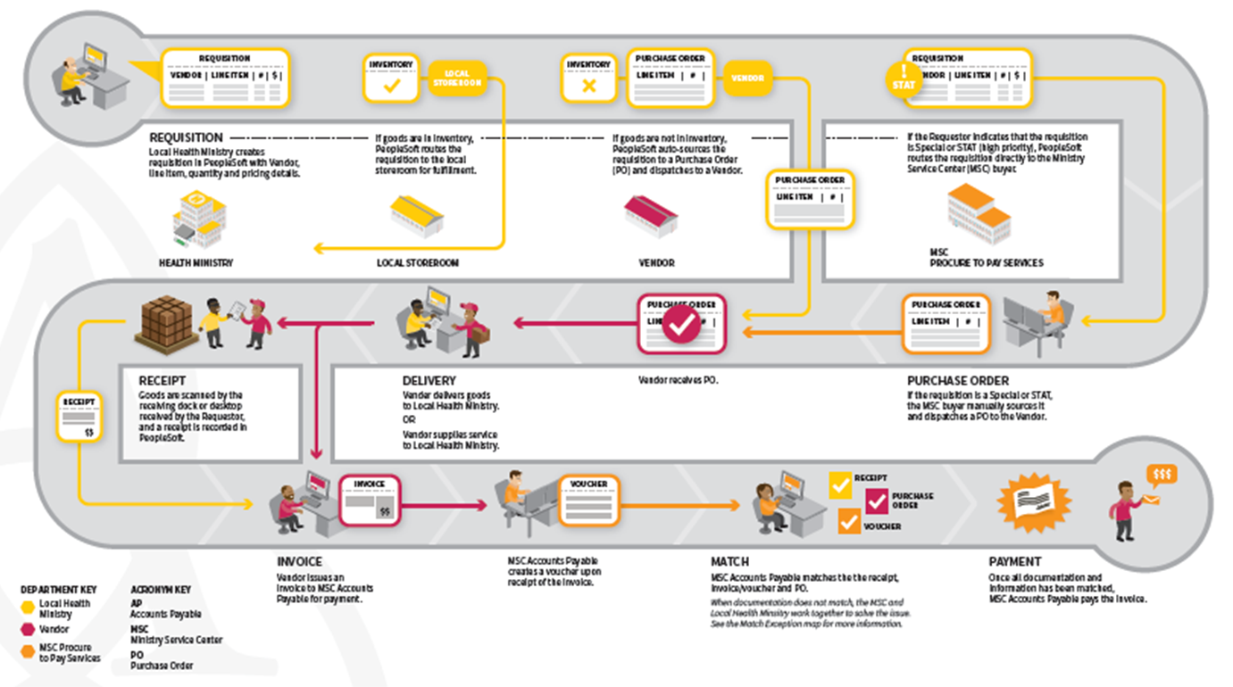
Procure-to-Pay Process Flow

Slide 13
Changes to Purchase Orders
POs will now be used for the majority of transactions with some exceptions; if you have not used Purchase Orders in the past, you will begin to receive them as part of the new process (PO exceptions: Donations, Leases, Taxes, Sponsorships, Chairmanships, Water, Electric, Gas and Ascension Technologies-approved Telecomm)
POs will be distributed electronically through EDI or the online PeopleSoft Supplier Portal as much as possible
PO numbers will be 15 digits in length, with the first 5 digits indicating the location and the final 10 digits indicating the PO number The complete 15-digit Purchase Order number must be used on all correspondence and invoicing.
Purchase Orders will state “AMITA Health” at the top of the document, as well as the name associated with the specific facility / affiliate ordering the goods or services

Slide 14
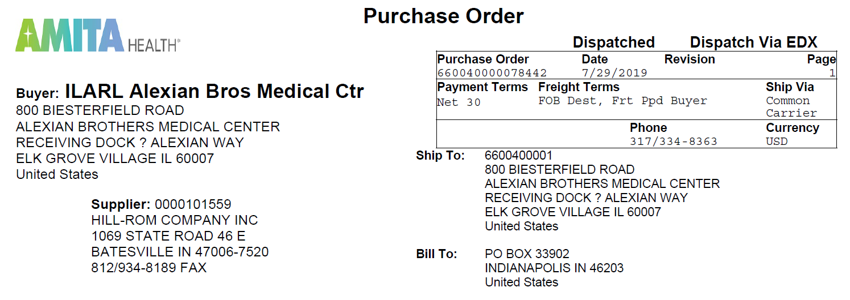
Changes to Purchase Orders
Name of health ministry
If the health ministry has multiple facilities, the facility name will be stated as well.
If the facility is an affiliate it will state “affiliate” only.
15-digit PO number
SAMPLE

Slide 15
Changes to Payments
Payments to suppliers will transition to electronic payment methods
Until accommodations for electronic arrangements are finalized, payments will be distributed via check from Ascension
Checks will be issued under the name “Ascension health ministry SVC CTR”
The payment terms per the existing negotiated contract or agreement will remain in place; otherwise the default payment term will be 60 days

Slide 16
Agenda
Background on Symphony Release 11
Overview of Changes
Changes to Purchase Orders, Invoices & Payments
PeopleSoft Supplier Portal Functionality
Amount Only Purchase Orders
Invoice Submissions
Reference Information / Questions

Slide 17
PeopleSoft SUPPLIER Portal
Suppliers may use the online PeopleSoft Supplier Portal to:
Review purchase order details
Check the status of invoices
View and download payment history
View and download remittance details
Request updates to supplier data
It is highly recommended that suppliers use the portal for faster processing times, reduction in paperwork and improved status tracking on invoices.

Slide 18
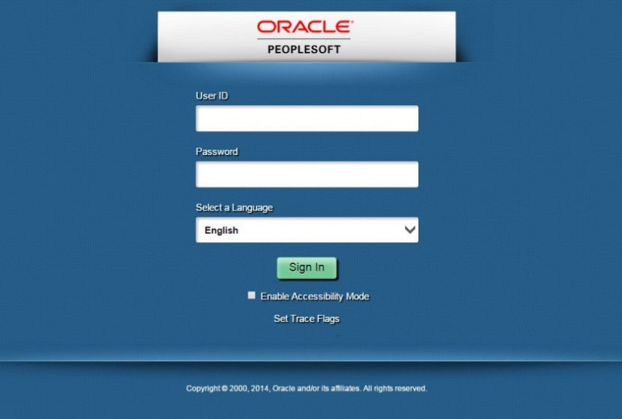
PeopleSoft SUPPLIER Portal
Suppliers access the PeopleSoft portal through an external website at: https://supplierportal.ascension.org
To access PeopleSoft, select ‘Sign In’.
A User ID and Password supplied by Ascension is required. If you have not registered, select ‘Request a User ID’

Slide 19
PeopleSoft SUPPLIER Portal Registration
New suppliers automatically receive a user ID and password when added to Ascension’s supplier master
If you are Portal user for another health ministry that is already using the new Ascension systems and processes, your PeopleSoft User ID and password will remain the same.
Suppliers can request additional / new user IDs via the portal
New users must provide supplier ID number(s) and Tax ID number(s) to request a user ID
Prior to using all the functionality of the portal, new users must review and approve a one-time supplier agreement. This agreement is a system requirement and only signifies agreement to have data populated in the portal; no contractual terms are contained in this agreement.
Suppliers can add multiple supplier IDs to one user ID

Slide 20
SUPPLIER Portal
Without logging into PeopleSoft, suppliers can use the external website (https://supplierportal.ascension.org) to:
Access the SARA template for invoice status inquiries
Can be used to check the status of a large list of invoices
1 business day (at most) response time (automated)
Access supplier resources
FAQs
Quick Reference Guides
Supplier Portal video tour
Supplier orientation packet
View and download sales tax exemption certificates for all Ascension health ministries

Slide 21
Agenda
Background on Symphony Release 11
Overview of Changes
Changes to Purchase Orders, Invoices & Payments
PeopleSoft Supplier Portal Functionality
Amount Only Purchase Orders
Invoice Submissions
Reference Information / Questions

Slide 22
AMOUNT ONLY Purchase Orders
Amount Only – a type of purchase order used for services, which allows the requester to enter a pre-determined budgeted amount and use the same purchase order number to pay for multiple invoices over time (sometimes known as blanket PO).
The end user at the local health ministry will submit a request (which is known as a requisition) for the dollar-amount needed (typically, for a full year)
Once the requisition has been submitted to the service center, the requisition will be reviewed and processed to a purchase order
Once the purchase order is created, the PO will be dispatched (sent) to the supplier in the manner set up in our system for that supplier.
The same PO number is then used on multiple invoices (from the supplier) until all funds on the PO are exhausted
When all the funds are exhausted, the end user will submit a new requisition in order to obtain a new PO number

Slide 23
AMOUNT ONLY PURCHASE ORDER QUESTIONS
What do I do if I have questions?
If you find the Amount Only purchase order is out of funds? Contact the end user to submit a new requisition.
To inquire on payments or any other questions, contact: Ascension Supplier Line: 317-334-8363 Monday – Friday, 8:00 a.m. – 6:00 p.m. ET

Slide 24
Agenda
Background on Symphony Release 11
Overview of Changes
Changes to Purchase Orders, Invoices & Payments
PeopleSoft Supplier Portal Functionality
Amount Only Purchase Orders
Invoice Submissions
Reference Information / Questions

Slide 25
Invoice Submission
Invoice Checklist For invoices to be properly processed in a timely manner, please include:
Supplier Name
Invoice Number
Valid 15-digit purchase order (PO) number; no hyphens, spaces or dashes
* all handwritten PO numbers will cause a payment delay due to manual processing
* no handwritten invoices
Remit to Address
Invoice Processing
Invoices are processed within 5-7 business days from the receipt date of the invoice. Once processed, payment will be issued based on supplier pay terms
Accounts Payable (A/P) will only pay from an invoice, not from a letter or a statement

Slide 26
Agenda
Background on Symphony Release 11
Overview of Changes
Changes to Purchase Orders, Invoices & Payments
PeopleSoft Supplier Portal Functionality
Amount Only Purchase Orders
Invoice Submissions
Reference Information / Questions

Slide 27
Reference Information / Questions
A communication will be sent to suppliers a few weeks prior to Go Live as a reminder about the upcoming changes. Additional resources are available at the PeopleSoft Supplier Portal website (https://supplierportal.ascension.org):
Ascension Supplier Webinar Presentation | Link to PeopleSoft Supplier Portal
Quick Reference Guides / FAQs Self-Paced Online Training | Contact Information Tax Exempt Certificates
Contact Information: 317.334.VEND (317.334.8363) / AHMSCVendor@ascensionhealth.org Invoice Email: invoices@ascensionhealth.org *Please note that invoices should be sent as attachments only. Any other content will be lost, as our system does not extract content or images in the email body. Each invoice must be sent as a separate attachment.
Invoice Fax:
317.334.7120
*Please note that this fax number is for invoices only.

